Slide 1


Our Data Legacy: Metadata and Data Publication Best Practices
Trinh Nguyen, Senior Environmental Scientist Specialist
Interagency Ecological Program
California Department of Fish and Wildlife
April 18, 2024

Slide 2
What to Expect in This Course
A detailed look at:
Metadata
Data publication best practices
Practical guidance to these concepts
Opportunities for collaboration

Slide 3

More to Come!
Full training later in the year, day-long
More in-depth discussion on these concepts
Workshop component to:
Showcase practical guidance
Application to your own data package

Slide 4
Table of Contents
Vision
Defining metadata
What are the benefits?
How do we do this?
Defining data publication
What are the benefits?
How do we do this?
Culture
Notes:
A comprehensive look at metadata and data publication best practices
Practice guidance and resources for data managers, publishers, and users
Opportunities for discussion and collaboration

Slide 5
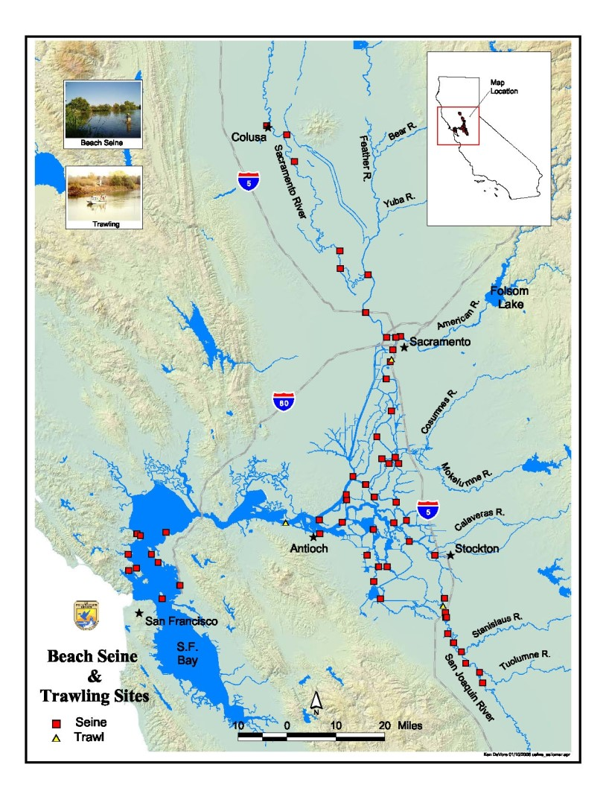
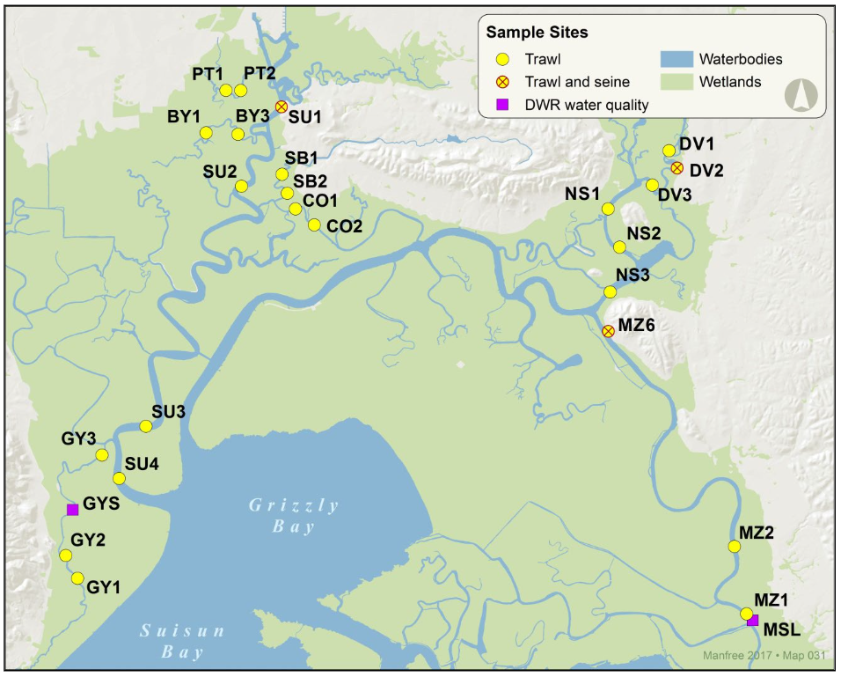
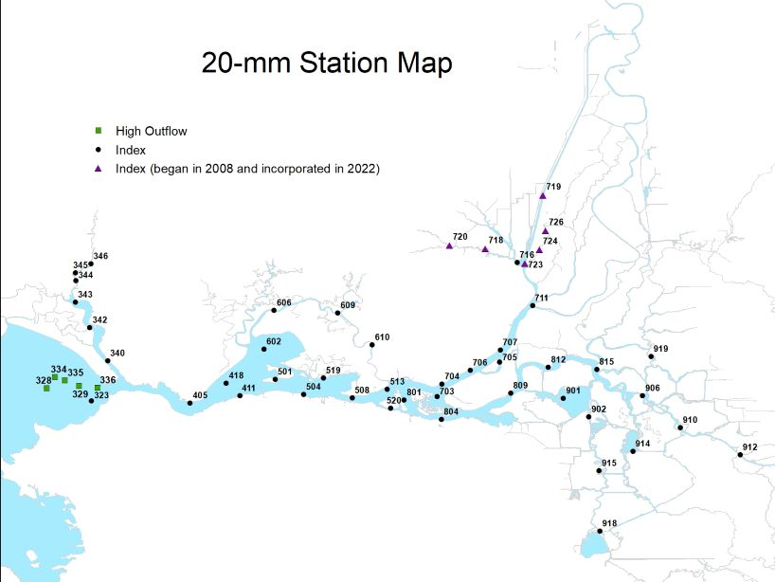
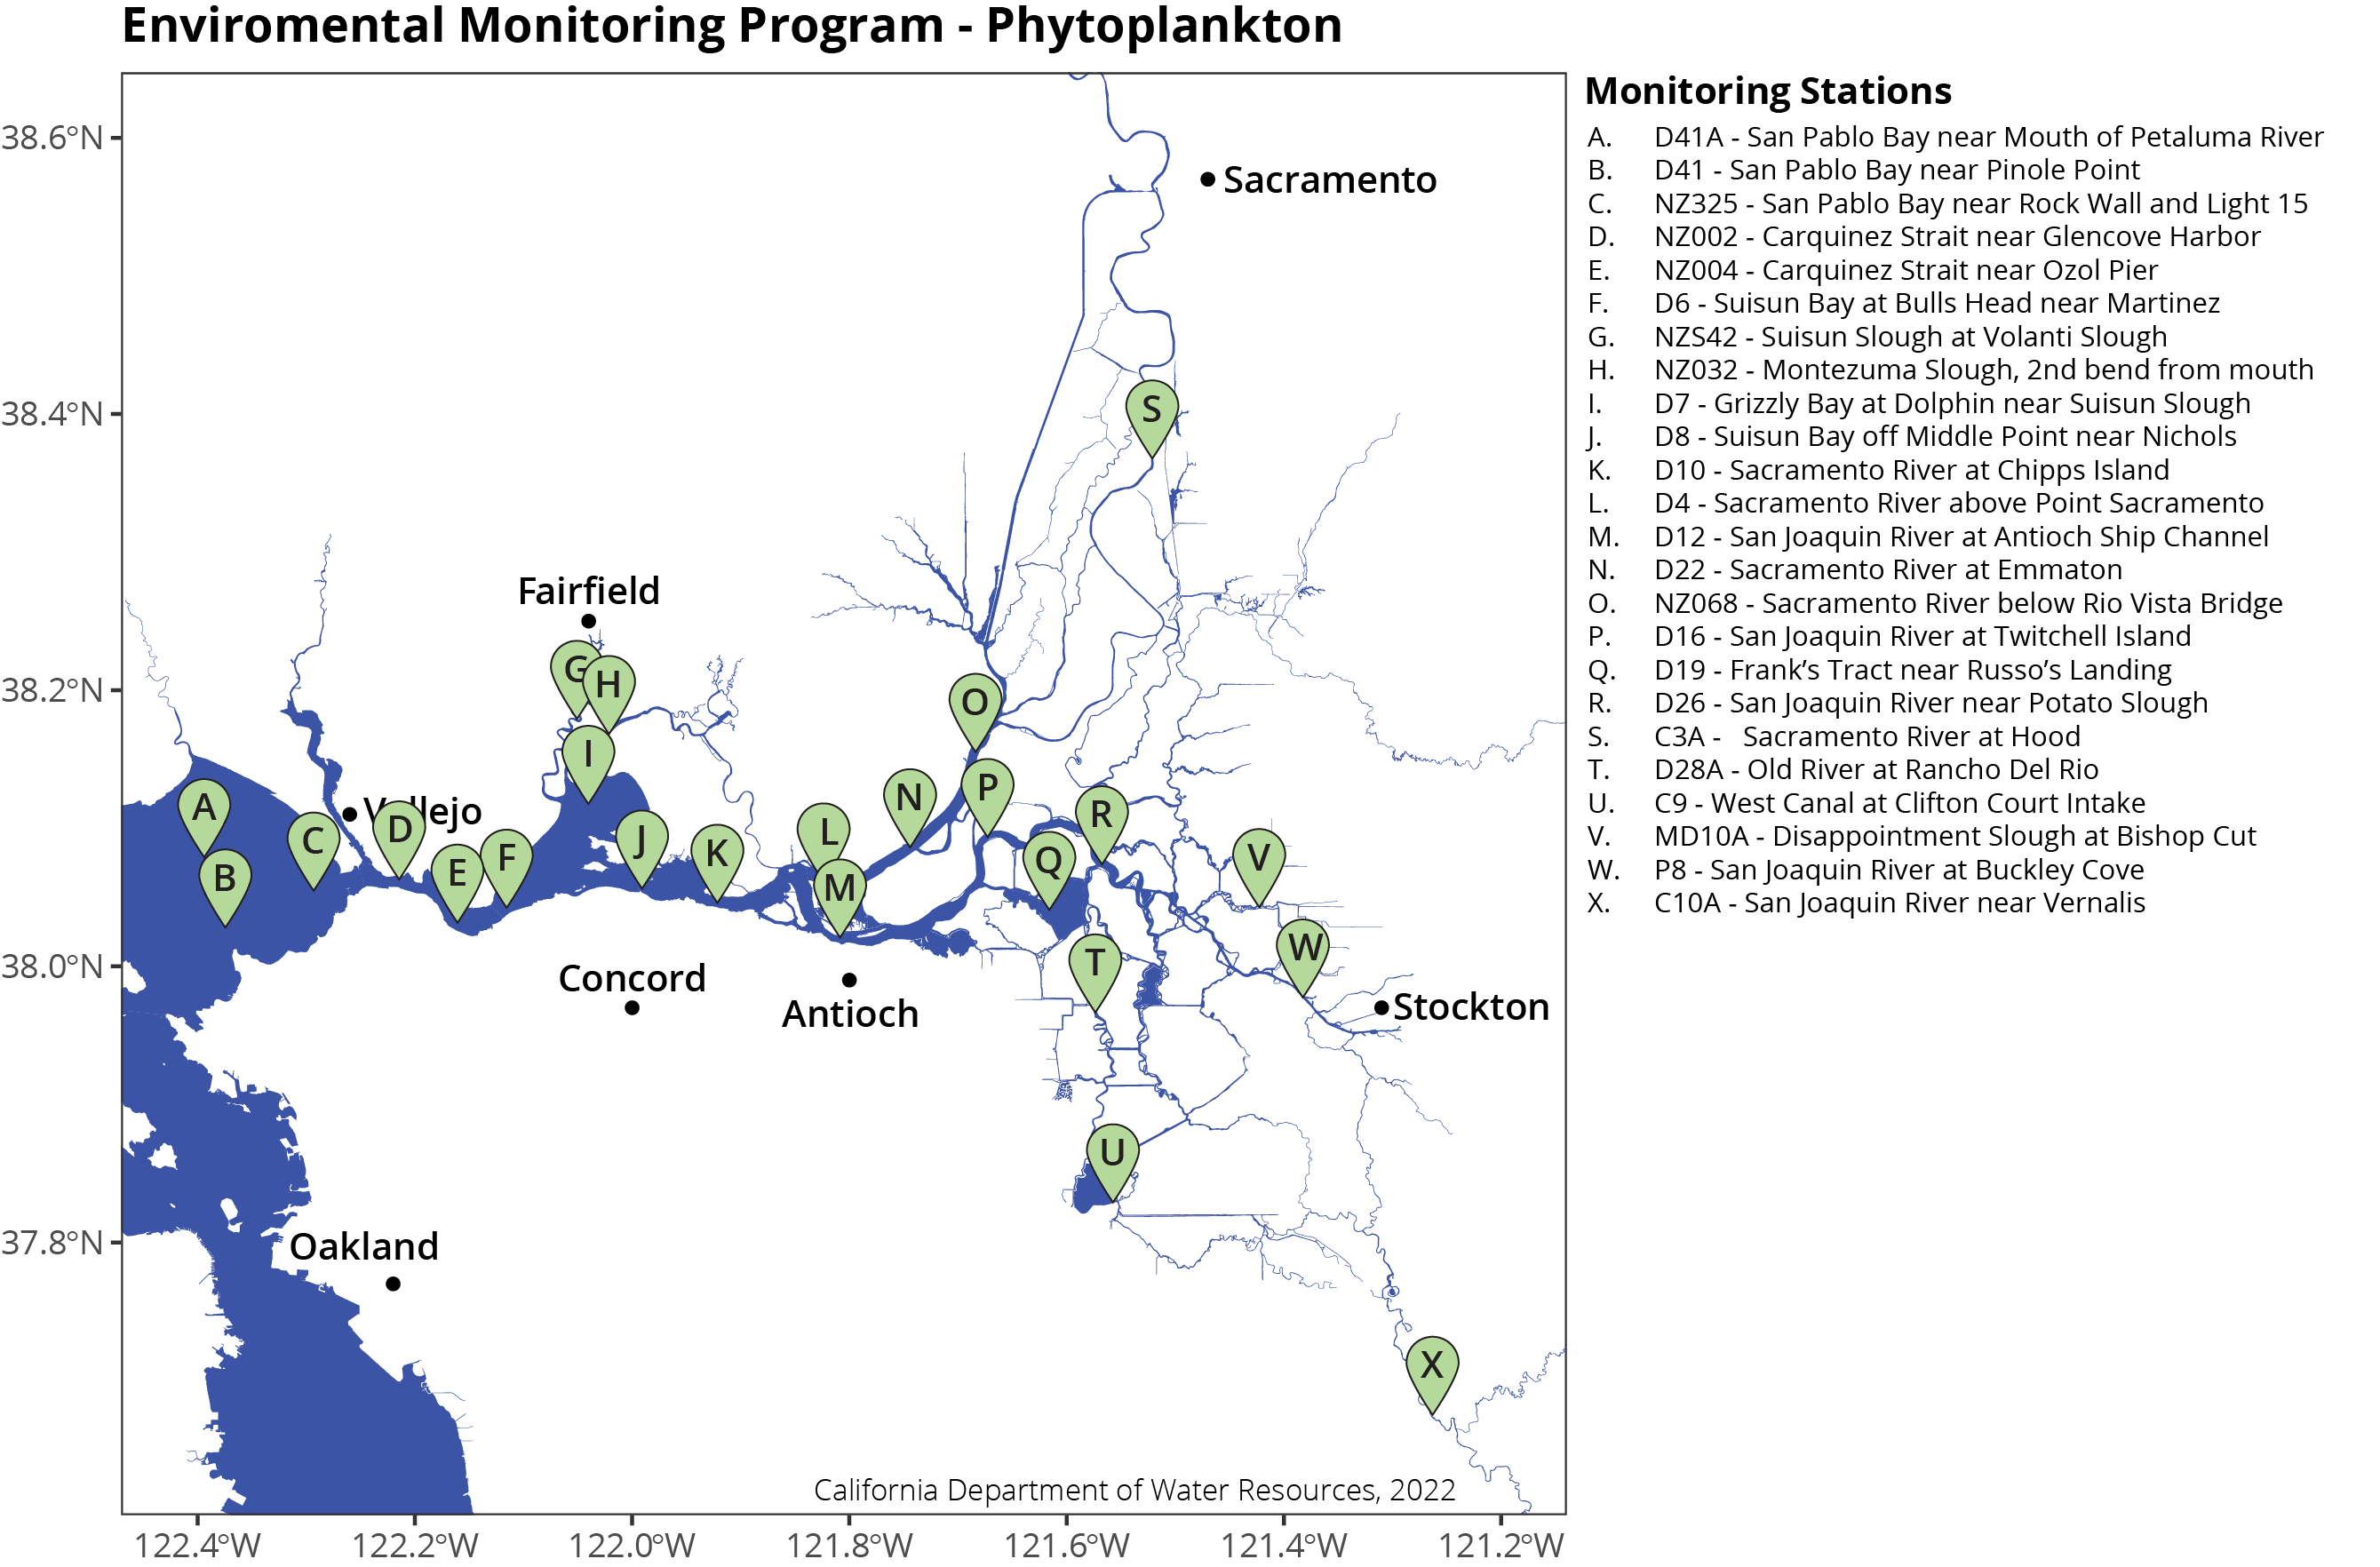
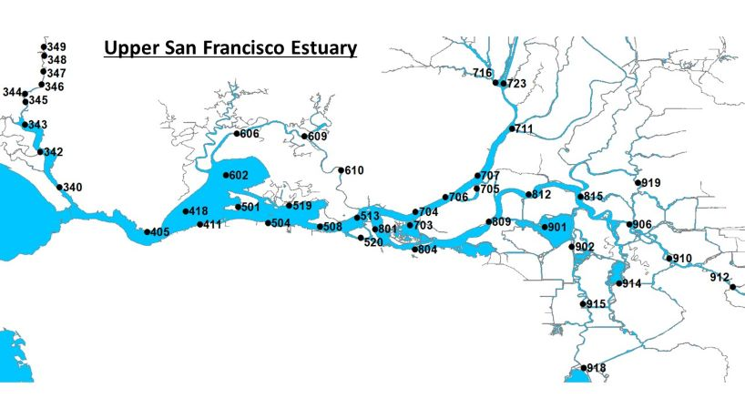
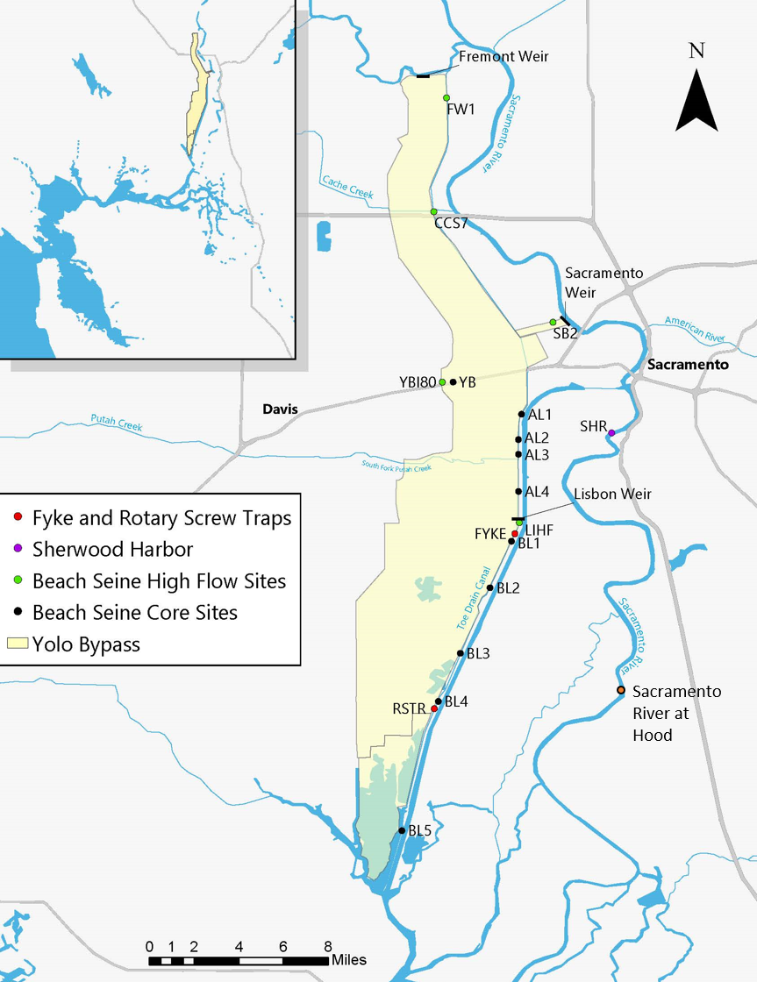
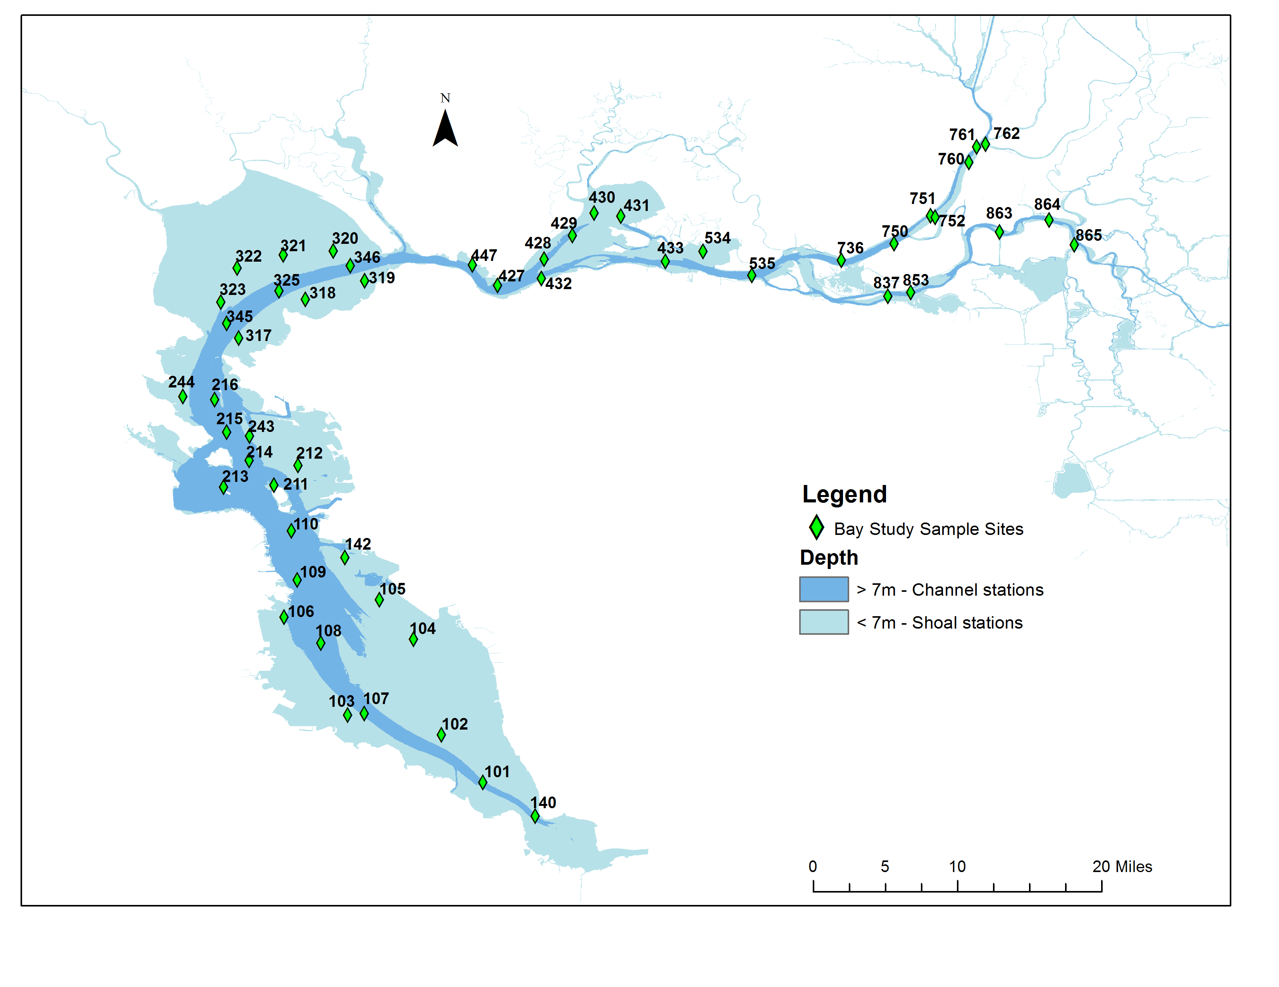
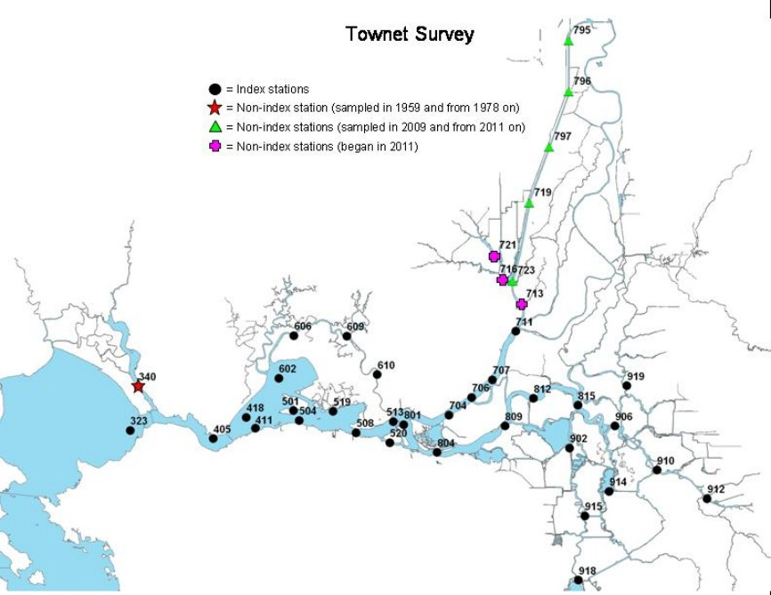
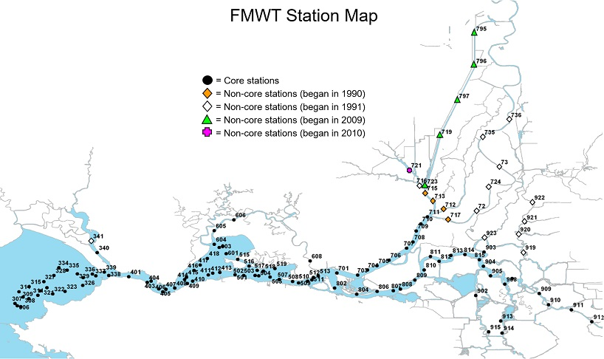
Vision

Slide 6

Vision: Useful Data
Data is valuable and impactful if:
It is used
It is used correctly
Useful Data
Usable Data
Documented
Updated
Data
Discoverable
Accessible
Relevant
Notes:
Used = discoverable, relevant, accurate
Used correctly =

Slide 7


Vision: Data Stewards
Data producers
Data stewards
Notes:
Don’t want this to seem like we are gatekeeping the data though.

Slide 8




Vision: Legacy
Management actions based on best available science
Best available science depends on best available data
Supplementation
Harvest
Water Management
Additional Studies
Additional Sampling
Notes:
Take limits
Water export management
Supplementation efforts
Research

Slide 9
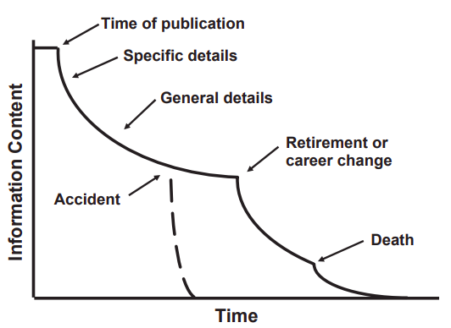
Vision: Legacy
Adapted from Michener et al., 1987
Notes:
Legacy of our dataset is as far reaching as possible.

Slide 10
Fighting Information Loss
Metadata!
Adapted from Michener et al., 1987

Slide 11
How comfortable are you with the concept of metadata?
Very comfortable, I work with metadata regularly
Somewhat comfortable, I have a basic understanding
Not very comfortable, I need more information
I am unfamiliar with the term “metadata”

Slide 12
Metadata fundamentals
Metadata is “data about data”
Many types, based on field and needs
Historical metadata
Provides critical context to help us:
Understand
Manage
Find, Access, and Use
Notes:
National information standards: organization that specializes in publishing and maintaining technical standards related to publishing, bibliographic, and library applications

Slide 13
How Useful can Metadata be: Only Data
PassengerId | Survived | Pclass | Name | Sex | Age | SibSp | Parch | Ticket | Fare | Cabin | Embarked
1 | 0 | 3 | Braund, Mr. Owen Harris | male | 22 | 1 | 0 | A/5 21171 | 7.25 |  | S
2 | 1 | 1 | Cumings, Mrs. John Bradley (Florence Briggs Thayer) | female | 38 | 1 | 0 | PC 17599 | 71.2833 | C85 | C
3 | 1 | 3 | Heikkinen, Miss. Laina | female | 26 | 0 | 0 | STON/O2. 3101282 | 7.925 |  | S
4 | 1 | 1 | Futrelle, Mrs. Jacques Heath (Lily May Peel) | female | 35 | 1 | 0 | 113803 | 53.1 | C123 | S
5 | 0 | 3 | Allen, Mr. William Henry | male | 35 | 0 | 0 | 373450 | 8.05 |  | S

Slide 14
How Useful can Metadata be: Column Names
PassengerId | Survived | Pclass | Name | Sex | Age | SibSp | Parch | Ticket | Fare | Cabin | Embarked
1 | 0 | 3 | Braund, Mr. Owen Harris | male | 22 | 1 | 0 | A/5 21171 | 7.25 |  | S
2 | 1 | 1 | Cumings, Mrs. John Bradley (Florence Briggs Thayer) | female | 38 | 1 | 0 | PC 17599 | 71.2833 | C85 | C
3 | 1 | 3 | Heikkinen, Miss. Laina | female | 26 | 0 | 0 | STON/O2. 3101282 | 7.925 |  | S
4 | 1 | 1 | Futrelle, Mrs. Jacques Heath (Lily May Peel) | female | 35 | 1 | 0 | 113803 | 53.1 | C123 | S
5 | 0 | 3 | Allen, Mr. William Henry | male | 35 | 0 | 0 | 373450 | 8.05 |  | S

Slide 15
How Useful can Metadata be: Keys
PassengerId | Survived | Pclass | Name | Sex | Age | SibSp | Parch | Ticket | Fare | Cabin | Embarked
1 | 0 | 3 | Braund, Mr. Owen Harris | male | 22 | 1 | 0 | A/5 21171 | 7.25 |  | S
2 | 1 | 1 | Cumings, Mrs. John Bradley (Florence Briggs Thayer) | female | 38 | 1 | 0 | PC 17599 | 71.2833 | C85 | C
3 | 1 | 3 | Heikkinen, Miss. Laina | female | 26 | 0 | 0 | STON/O2. 3101282 | 7.925 |  | S
4 | 1 | 1 | Futrelle, Mrs. Jacques Heath (Lily May Peel) | female | 35 | 1 | 0 | 113803 | 53.1 | C123 | S
5 | 0 | 3 | Allen, Mr. William Henry | male | 35 | 0 | 0 | 373450 | 8.05 |  | S
Variable | Definition | Key
Survival | Survival | 0 = No, 1 = Yes
pclass | Ticket class | 1 = 1st, 2 = 2nd, 3 = 3rd
sex | Sex
Age | Age in years
sibsp | # of siblings / spouses aboard
parch | # of parents / children aboard
ticket | Ticket number
fare | Passenger fare
cabin | Cabin number
embarked | Port of Embarkation | C = Cherbourg, Q = Queenstown, S = Southampton
Notes:
C = France; S = England; Q = Ireland

Slide 16
How Useful can Metadata be: Notes
PassengerId | Survived | Pclass | Name | Sex | Age | SibSp | Parch | Ticket | Fare | Cabin | Embarked
1 | 0 | 3 | Braund, Mr. Owen Harris | male | 22 | 1 | 0 | A/5 21171 | 7.25 |  | S
2 | 1 | 1 | Cumings, Mrs. John Bradley (Florence Briggs Thayer) | female | 38 | 1 | 0 | PC 17599 | 71.2833 | C85 | C
3 | 1 | 3 | Heikkinen, Miss. Laina | female | 26 | 0 | 0 | STON/O2. 3101282 | 7.925 |  | S
4 | 1 | 1 | Futrelle, Mrs. Jacques Heath (Lily May Peel) | female | 35 | 1 | 0 | 113803 | 53.1 | C123 | S
5 | 0 | 3 | Allen, Mr. William Henry | male | 35 | 0 | 0 | 373450 | 8.05 |  | S
Variable | Definition | Key
Survival | Survival | 0 = No, 1 = Yes
pclass | Ticket class | 1 = 1st, 2 = 2nd, 3 = 3rd
sex | Sex
Age | Age in years
sibsp | # of siblings / spouses aboard
parch | # of parents / children aboard
ticket | Ticket number
fare | Passenger fare
cabin | Cabin number
embarked | Port of Embarkation | C = Cherbourg, Q = Queenstown, S = Southampton
Variable Notes
pclass: A proxy for socio-economic status (SES)
1st = Upper, 2nd = Middle, 3rd = Lower
age: Age is fractional if less than 1. If the age is estimated, it is in the form of xx.5
sibsp: The dataset defines family relations in this way…
Siblings = brother, sister, stepbrother, stepsister
Spouse = husband, wife (mistresses and fiancés were ignored)
parch: The dataset defines family relations in this way…
Parents = mother, father
Child = daughter, son, stepdaughter, stepson
Some children travelled only with a nanny, therefore parch=0 for them.

Slide 17
What dataset is this?
Results from series of medical treatments
Immigration records for a specific country
Passenger data from a cruise ship
Demographic information from a historical survey

Slide 18
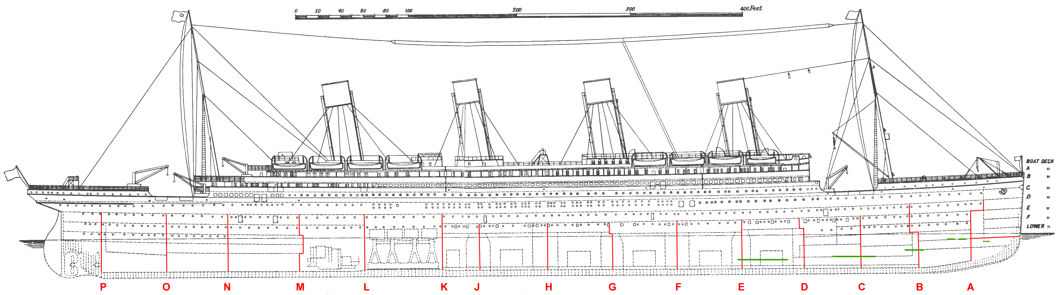
How Useful can Metadata be: Notes
Name | Cabin
Braund, Mr. Owen Harris
Cumings, Mrs. John Bradley (Florence Briggs Thayer) | C85
Heikkinen, Miss. Laina
Futrelle, Mrs. Jacques Heath (Lily May Peel) | C123
Allen, Mr. William Henry
Moran, Mr. James
McCarthy, Mr. Timothy J | E46
Palsson, Master. Gosta Leonard
Johnson, Mrs. Oscar W (Elisabeth Vilhelmina Berg)
Nasser, Mrs. Nicholas (Adele Achem)
Sandstrom, Miss. Marguerite Rut | G6
Bonnell, Miss. Elizabeth | C103
1st class
2nd class
3rd class
Notes:
3rd class cabins lowest decks

Slide 19
Why metadata matters
A foundation to build the legacy of the dataset on
Adapted from Michener et al., 1987

Slide 20
How important do you think comprehensive metadata documentation is for IEP datasets?
Extremely important, essential for data usability
Important, but not always necessary
Somewhat important, mainly to know what the columns are
Not very important, the data speaks for itself

Slide 21
IEP Datasets
Long term-datasets
Ecological data is diverse: IEP data spans many types
Dataset | Start Year | End Year | Target
Environmental Monitoring Program | 1971 | Present | Phyto- and Zooplankton, WQ and Nutrients, Benthic
Bay Study | 1980 | Present | Fish, Shrimp, Crab, WQ
Summer Tow Net | 1959 | Present | Fish, WQ
Fall Midwater Trawl | 1967 | Present | Fish, WQ, Zooplankton
Yolo Bypass | 1998 | Present | Fish, WQ, Zooplankton
Delta Juvenile Fish Monitoring Program | 1970s | Present | Fish, WQ, Zooplankton
20mm | 1995 | Present | Larval Fish, Zooplankton

Slide 22
Importance of Historical Metadata
Refers to documentation of the origin, modifications, and movements of data over time.
Extremely important for IEP surveys:
Long-term surveys
Tendency to focus only on current metadata
Project started
Sixth survey added
Two additional surveys added
2008
2010
2012
2014
2016
2018
2020
2022
2024
Napa River stations added
Napa River stations removed
SPB stations added
Napa River stations added
Notes:
“history of data and how it was computed” (Lerner et al., 2022)

Slide 23

Where do we Start: Metadata Standards
List of standardized elements to facilitate consistency
Structured approach enables:
Discovery
Accessibility
Automation
Reuse
Interoperability
Ease of use, for all
Metadata
Element – Title
Element – PIs
Element – Publication Date
Element – Abstract
Element – Package ID
Element – Data Table(s)
Element – Intellectual Rights
Notes:
Lists of standardized elements
Key to getting started is recognizing that datasets, regardless of their specific content, share common elements of metadata.

Slide 24
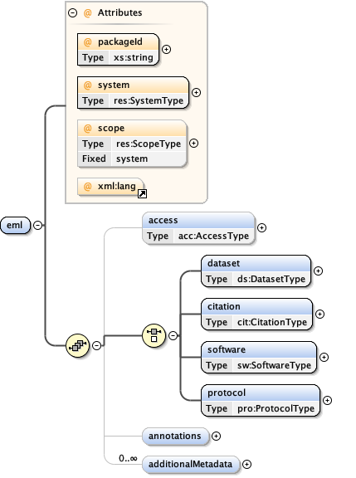

Metadata Standards: EML
Ecological metadata language
Curated specifically for ecological data
Nested structure
XML
Element
(Elements)
(Attributes)
Attributes
Ideal for complex ecological data
Notes:
Lists of standardized elements
1997
Ecological community

Slide 25
EML Example
SLS
Creator
Organization Name: Interagency Ecological Program (IEP)
Data Entities
Data Table
Name: Catch.csv
Description: Fish catch data from the Smelt Larval Survey
Table Structure
Size: 297714 byte
Table Column Descriptions
Attribute
Column Name: Date
Definition: Date when sampling occurred
Attribute
Column Name: Station
Definition: Project station number

Slide 26
Metadata Standards: Adopting EML
Made with ecological data in mind
Comprehensive
Extendable
Important to serve IEP datasets, e.g., historical metadata
Officially supported standard of the Environmental Data Initiative (EDI)
Infrastructure in place to help guide users
ezEML
EMLassemblyline (EAL)

Slide 27
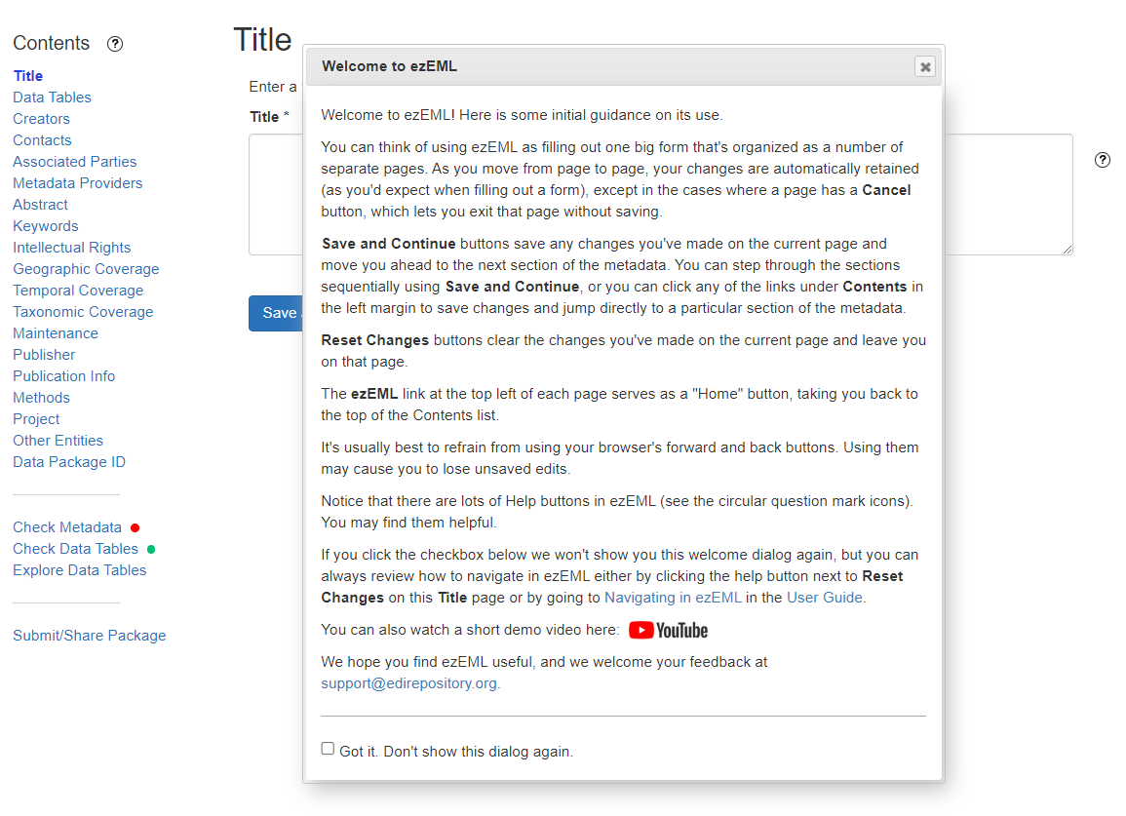

Slide 28
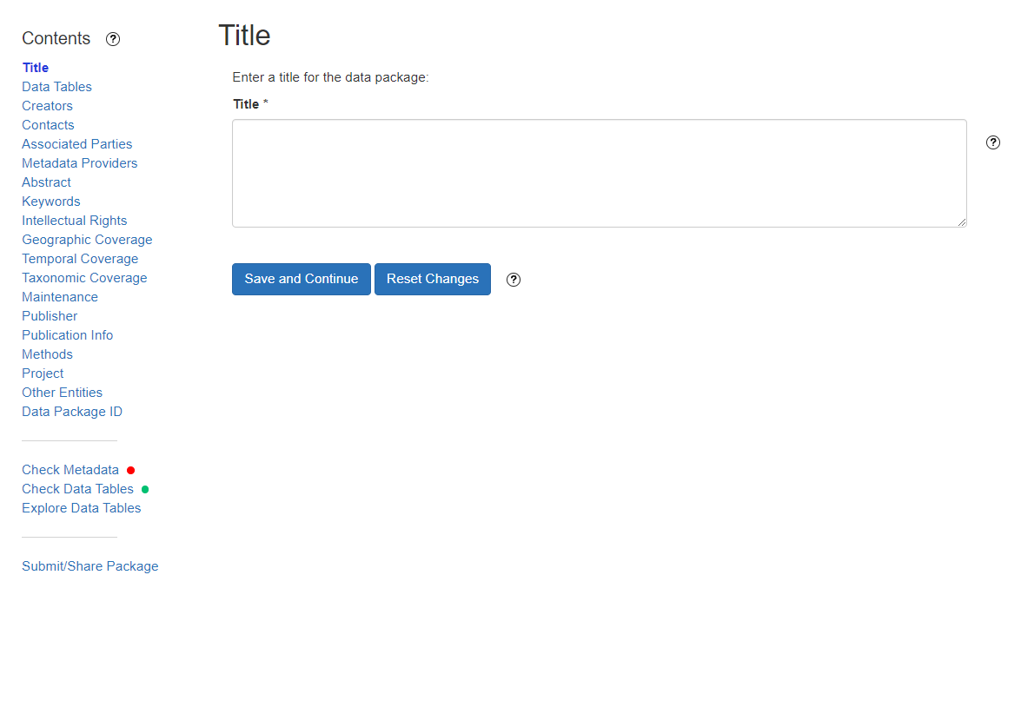

Slide 29
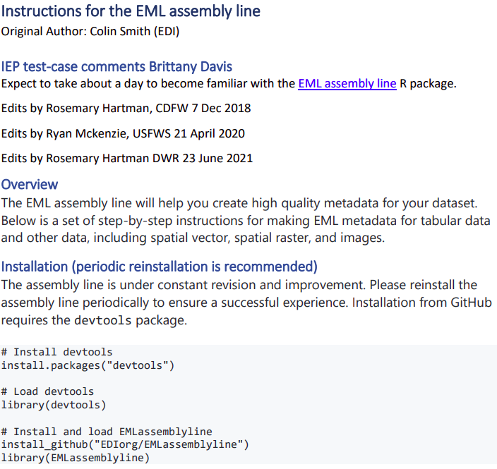
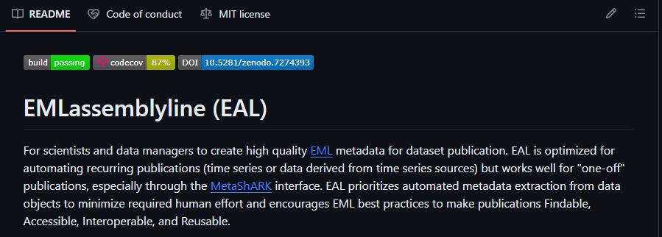
EMLassemblyline
Programmatically create EML metadata, R
Upload data package to a repository
Automate data publication process
https://github.com/EDIorg/EMLassemblyline?tab=readme-ov-file

Slide 30
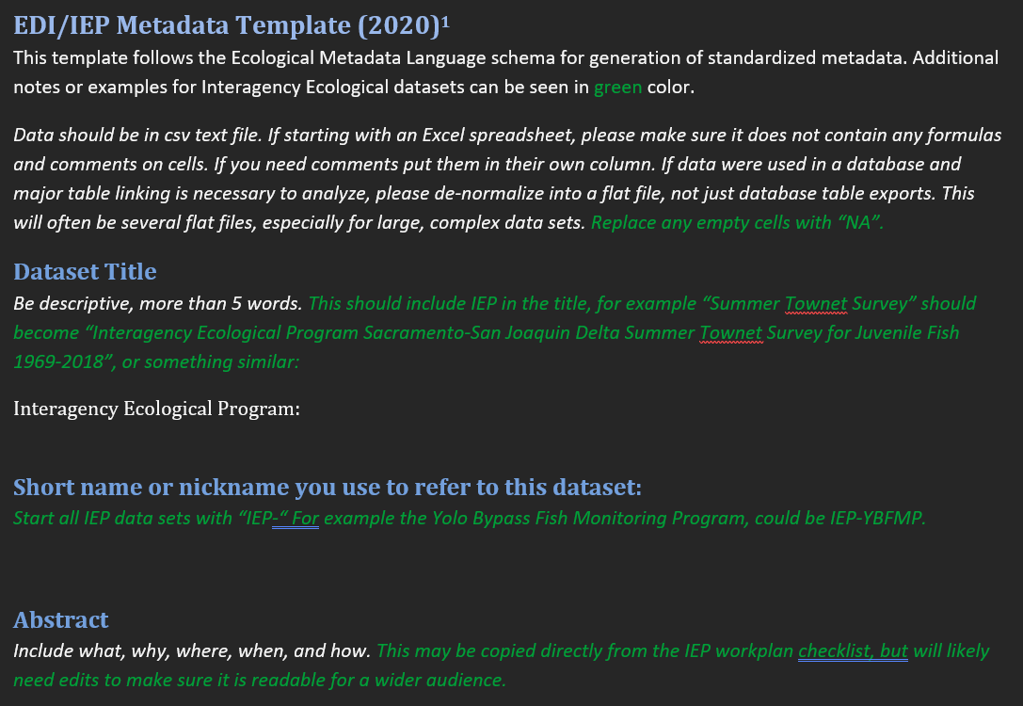
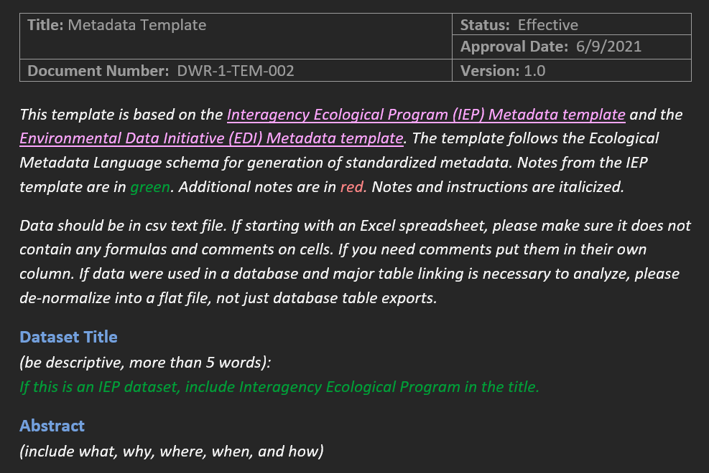
Template guides
IEP EDI Metadata Template 2020.docx

Slide 31
Which tool can you see yourself using to document rich metadata?
ezEML, the wizard seems straightforward enough
EAL, I am comfortable using R and automation is critical
IEP Word Document, a pre-formatted template is easy to follow
None, I prefer to use other methods

Slide 32
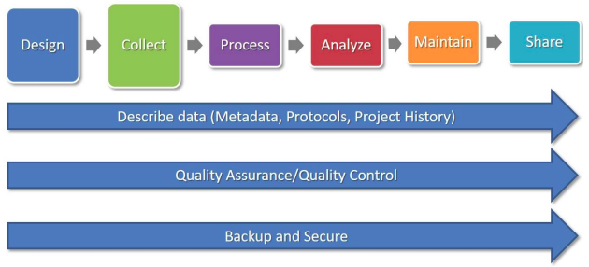
Data Publication: Goal
Making our research data publicly available to facilitate:
Data discovery
Access and use
Reuse

Slide 33
Data Publication: Benefits
Stewards | Users | Community
Contractual obligations | Ease of accessibility | Increased collaboration
Enhances transparency | Increased data quality and trustworthiness | Accelerates scientific progress
Increased visibility | Increased use and reuse | Promotes open science
Increased recognition | Increased efficiency | Supports evidence-based decision making
Increased impact
Improved data management
Promotes data preservation

Slide 34




Where do we start: FAIR
FAIR principles: meant to enhance
Findable
Accessible
Interoperable
Reusable
Developed by an international team (Wilkinson et al., 2016)
Gold standard for the industry
Notes:
Beyond just publication, but we can focus on that here
Generally, for management, stewardship, and publication
Set of guidelines

Slide 35

FAIR: Summary
https://www.go-fair.org/fair-principles/
Revolves around:
Document metadata thoroughly
Adopt a metadata standard
Lean on accepted infrastructure

Slide 36

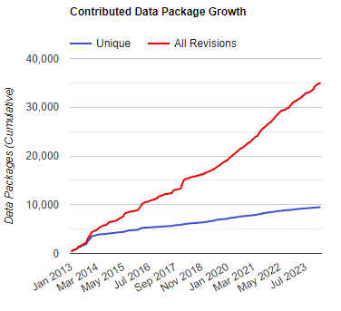
FAIR: EDI Repository
Environmental Data Initiative (EDI)
A data repository
Existing infrastructure to support FAIR data
Unique and persistent DOIs per data package
Utilizes EML to produce rich metadata
Part of a data federation, DataONE
Access with any browser or through an API
Guidance and support
ezEML, EMLassemblyline, assessment reports
Dedicated curation team
Version control and data preservation
Notes:
What kind of identifier to use? What open protocol to allow for access? Length of your title, abstracts, how many keywords

Slide 37
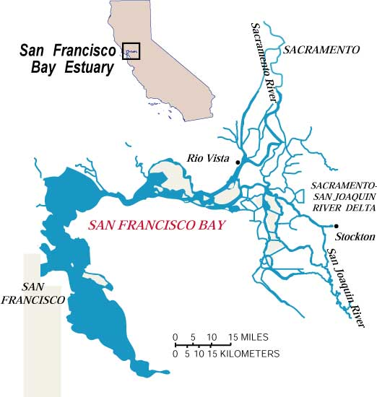
FAIR and EML: Great Initial Steps
Ecological data is diverse and unique to each system
Things to consider:
System-specific data types
Long-term datasets
System-specific reporting requirements
Required data portals, reporting frequencies
Existing infrastructure
Excel or Access based
Scripted QAQC queries
https://wwwrcamnl.wr.usgs.gov/tracel/data/ag_sfbay/sfbaymap.htm

Slide 38
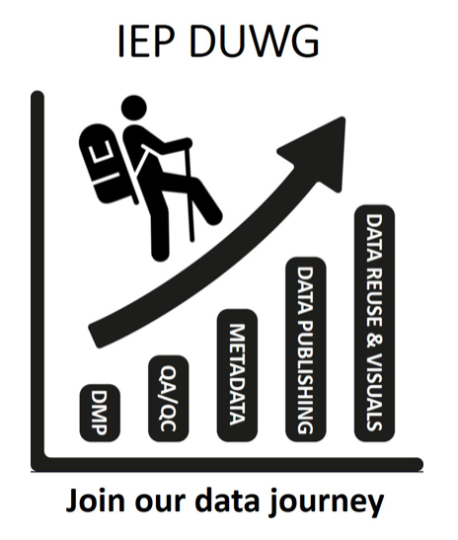
Data Publication Working Group
A DUWG subgroup focused on providing guidance more specific to our system
Two main functions:
Develop guidance for the community:
Guidelines, e.g., data publication best practices
Templates, e.g., historical metadata template
Guides, e.g., publishing to EDI

Slide 39
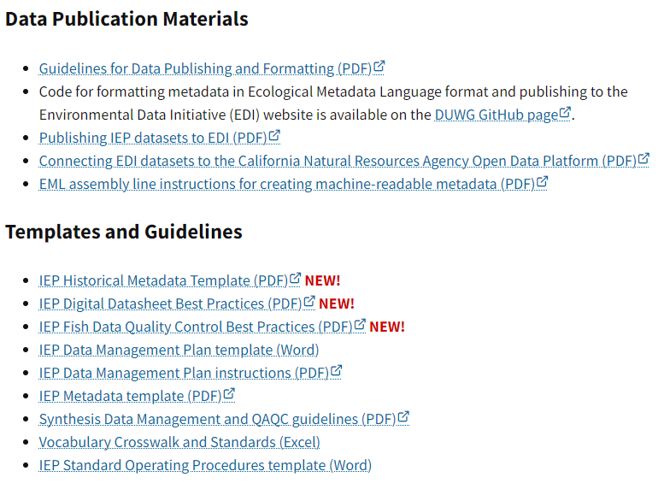
DUGW and DPWG Products
https://iep.ca.gov/Data/Data-Utilization-Working-Group
Homepage > Data > Data Utilization Working Group

Slide 40
Data Publication Working Group
A DUWG subgroup focused on providing guidance more specific to our system
Two main functions:
Develop guidance for the community:
Guidelines, e.g., data publication best practices
Templates, e.g., historical metadata template
Guides, e.g., publishing to EDI
Serve as an open forum to help IEP surveys through the publication process
Provide relevant guidance
Review drafted publication packages

Slide 41
Which data repositories do you prefer to use for data publication?
EDI Repository
California Natural Resources Agency Open Data Platform
In-house network, e.g., FTP
None, reach out to me personally for data

Slide 42
A Barrier to Consider: Culture
Transition from data producers to data stewards
Data stewards manage and oversee our datasets to help users discover and use our datasets correctly
Data stewardship: two parts
Technical guidelines
Attitudes, behavior, and practices

Slide 43
Why should we care?
Best available science depends on best available data
Helps drive meaningful changes to our system and field
The future is infinite, and so is the potential use of our data
Each line of useful data that we produce is a part of our legacy we leave behind
Adapted from Michener et al., 1987
Notes:
Technical and culteral barriers

Slide 44
Why should we care?
Time of publication
Best available science depends on best available data
Helps drive meaningful changes to our system and field
The future is infinite, and so is the potential use of our data
Each line of useful data that we produce is a part of our legacy we leave behind
Specific details
General details
Retirement or
career change
Adapted from Michener et al., 1987
Notes:
Technical and culteral barriers

Slide 45
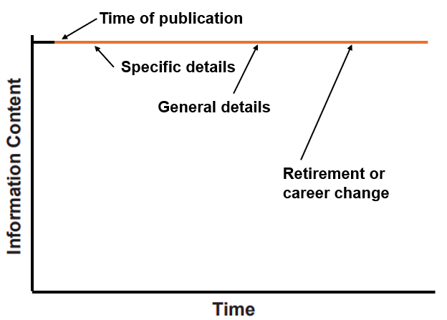
How can we start?
Prioritize documenting comprehensive metadata for all IEP datasets
Explore publication through the EDI repository
Engage with the DPWG to follow and develop best practices
Develop and embrace a culture of data stewardship to leave a lasting legacy through our research data
Thank you!
Adapted from Michener et al., 1987

